Slide 1
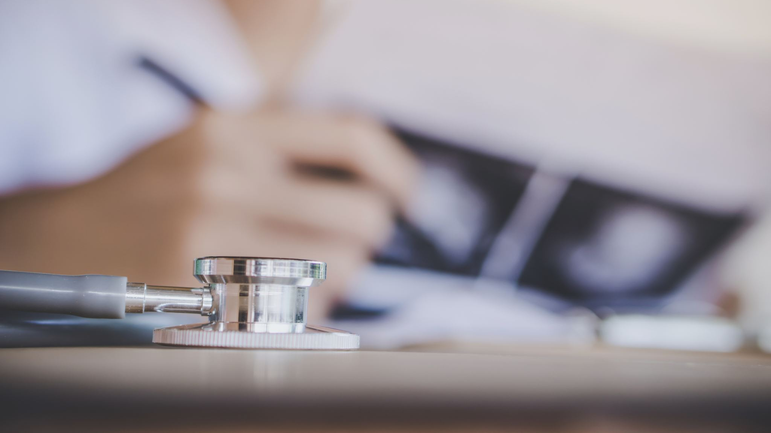
AI-Powered Medical Diagnosis Application
Enhancing Healthcare Accessibility and Accuracy

Slide 2
Problem Statement
Time constraints and diagnostic errors in healthcare.
Lack of access to medical specialists in underserved/remote areas.
Identified disease may be delayed, resulting in poor patient outcomes.
Growing need for healthcare services vs. shortage of professionals.
The necessity for a solution to enhance diagnosis speed and accuracy.

Slide 3
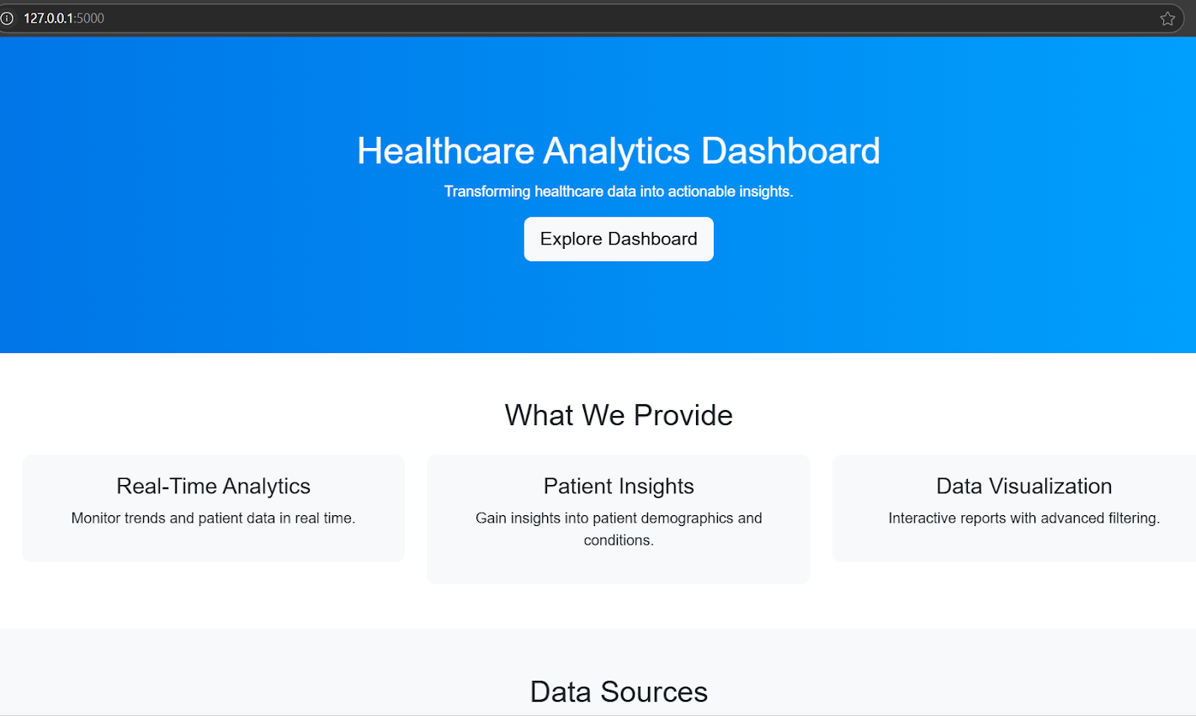
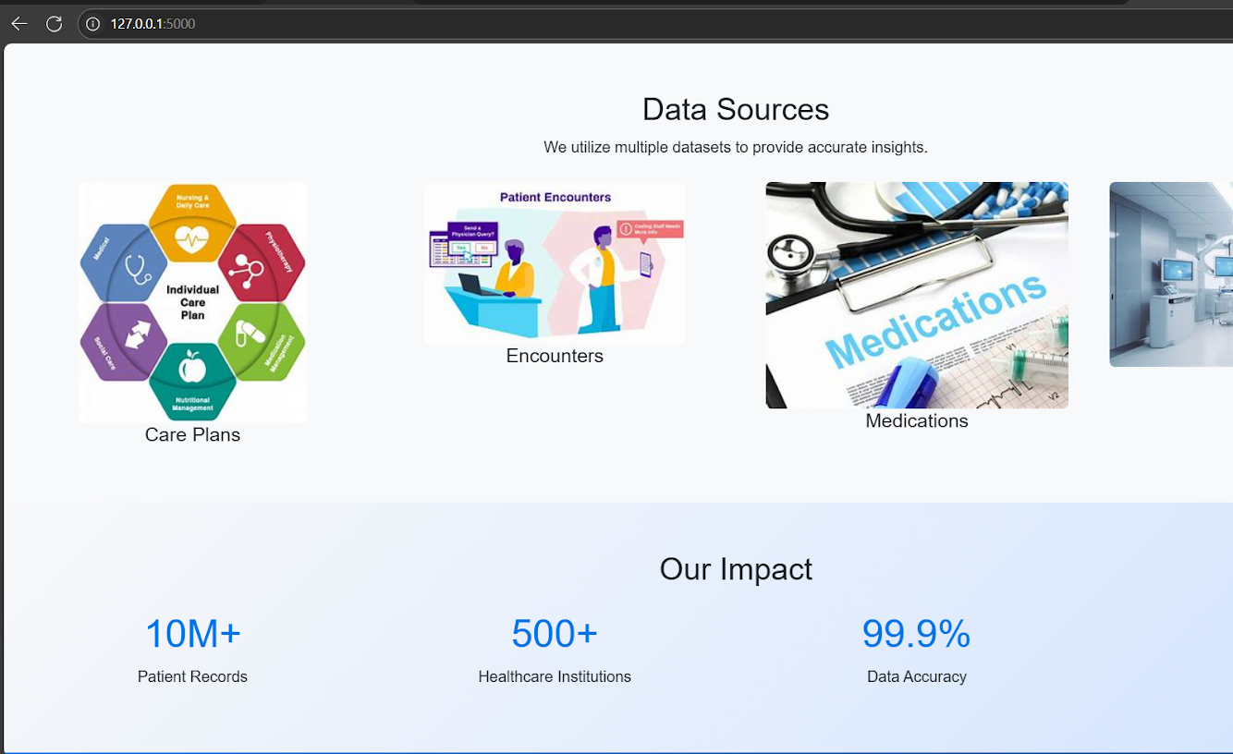
Solution Overview
AI-powered application for faster and more accurate diagnosis.
NLP is used to get patients to input symptoms by text or voice.
Confidence scores are given to the diseases suggested by the machine learning models.
It empowers healthcare professionals and patients with quick insights.
Integration with wearable devices for real-time monitoring.

Slide 4
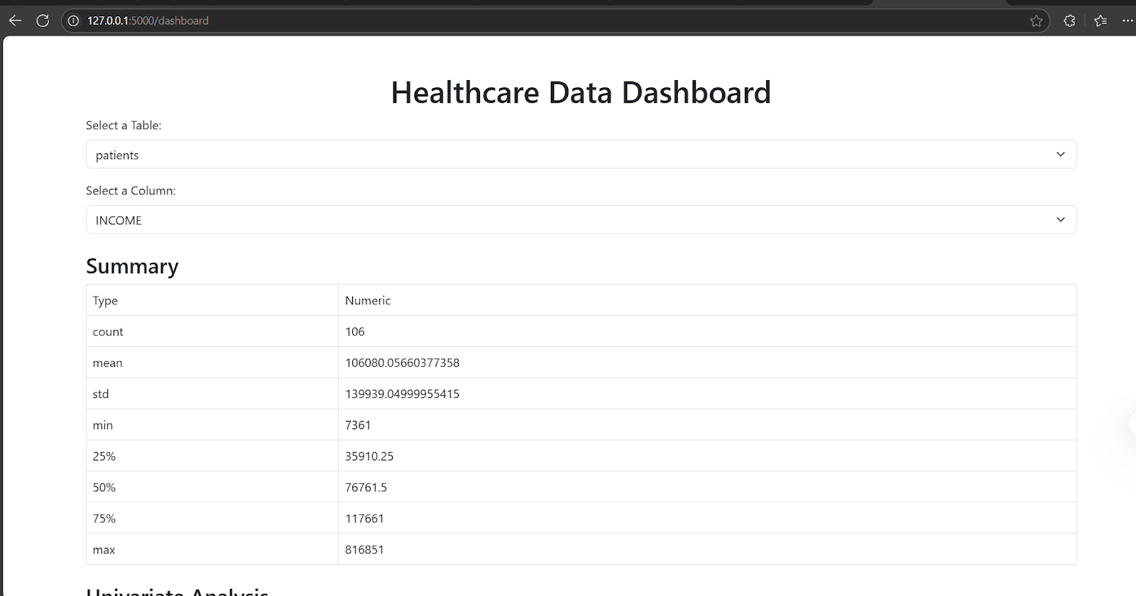
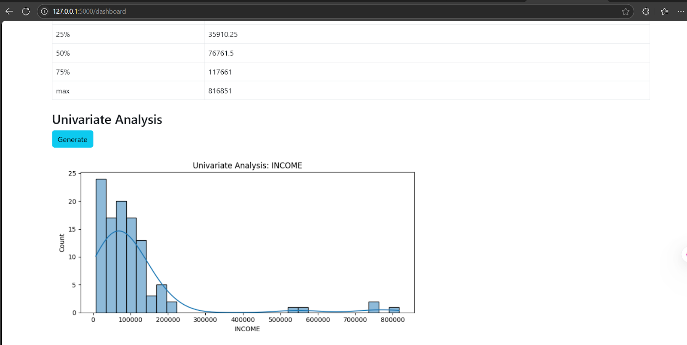
Application Features
Symptom Input: Symptoms can be inputted by patients in text or voice.
Disease Suggestions: AI throws possible disease with confidence scores.
Interactive Dashboard: Intuitive and user-friendly interface for healthcare professionals.
Real-Time Exploration: Dynamic updates from real time exploration of the data set with user selections.
Data Visualization: Better decision making made easier with better charts and graphs.

Slide 5
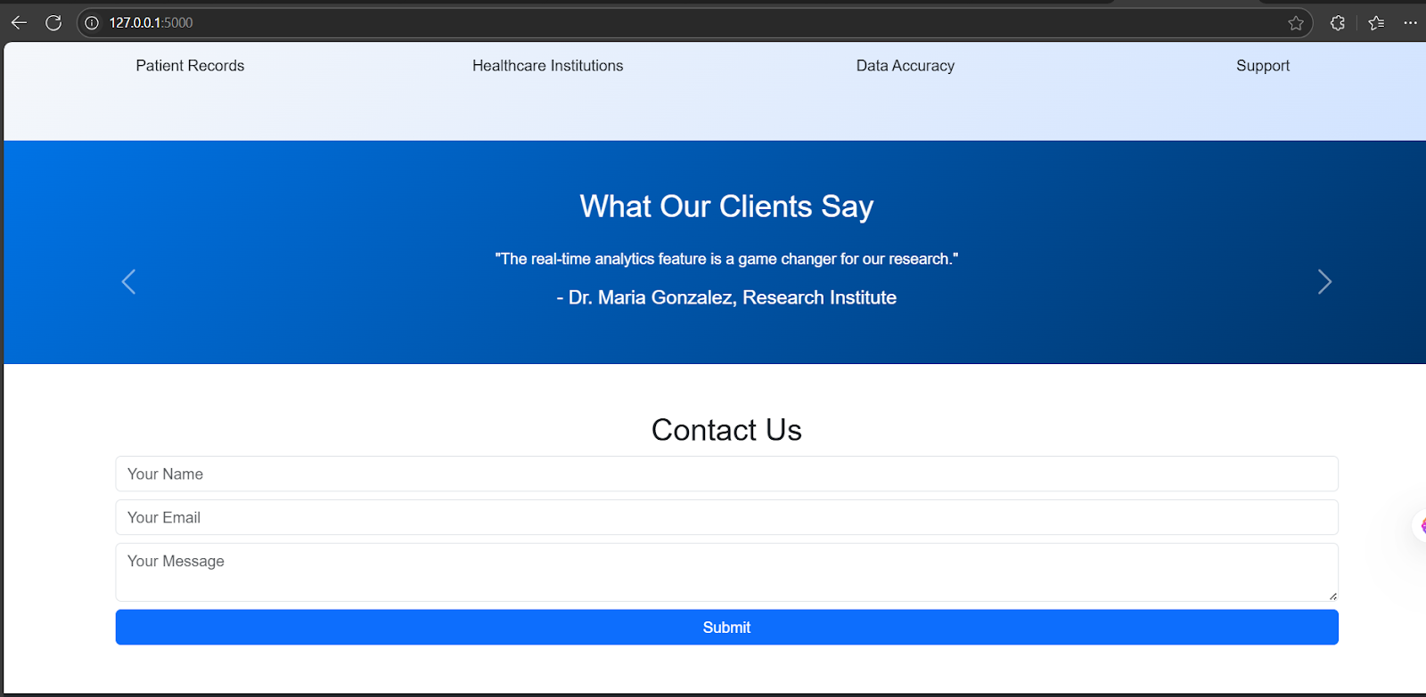
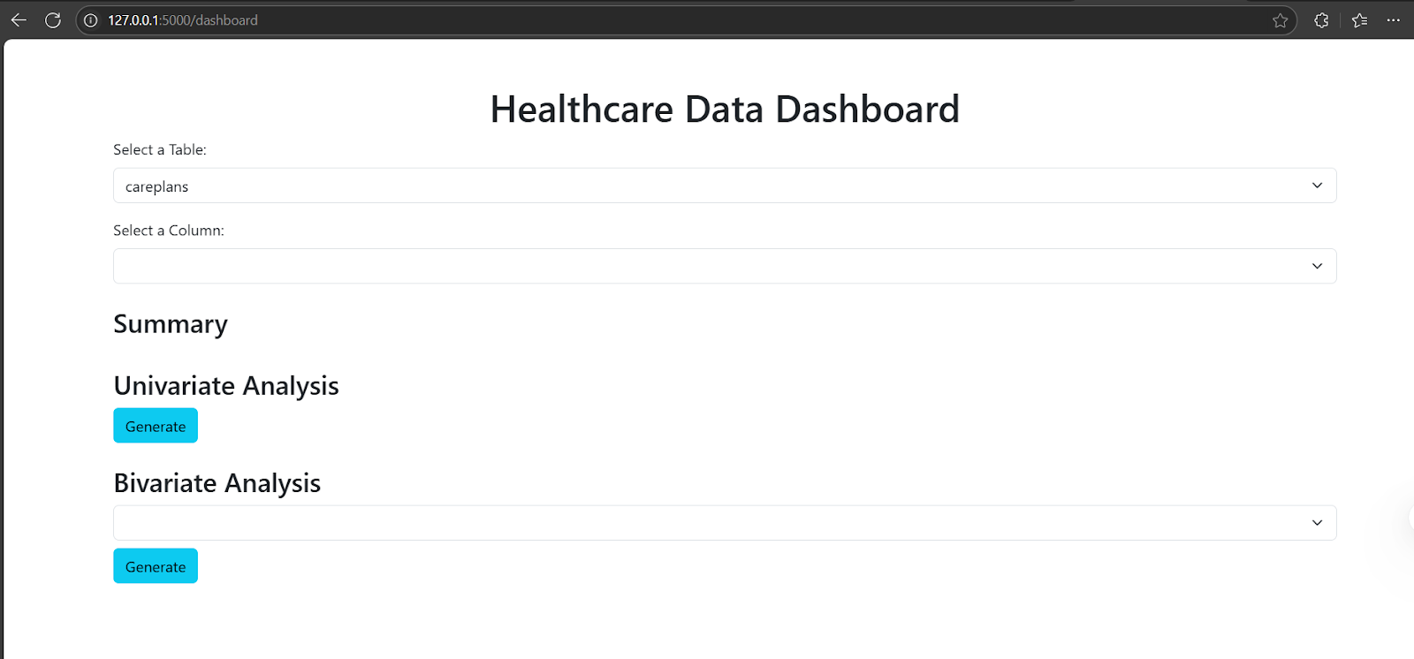
Data Integrity and Validation
Referential Integrity: Verified patient_id across tables (e.g. encounters, devices, conditions) Referential integrity.
Field-Level Validation: Those were checked dates, healthcare expenses, and confidence scores at field level.
Manual Checks: Reviewed outliers and inconsistencies.
Automated Scripts: Validation used SQL and Python as automated scripts.
No Data Integrity Issues Found: Ensured reliable data for analysis.

Slide 6
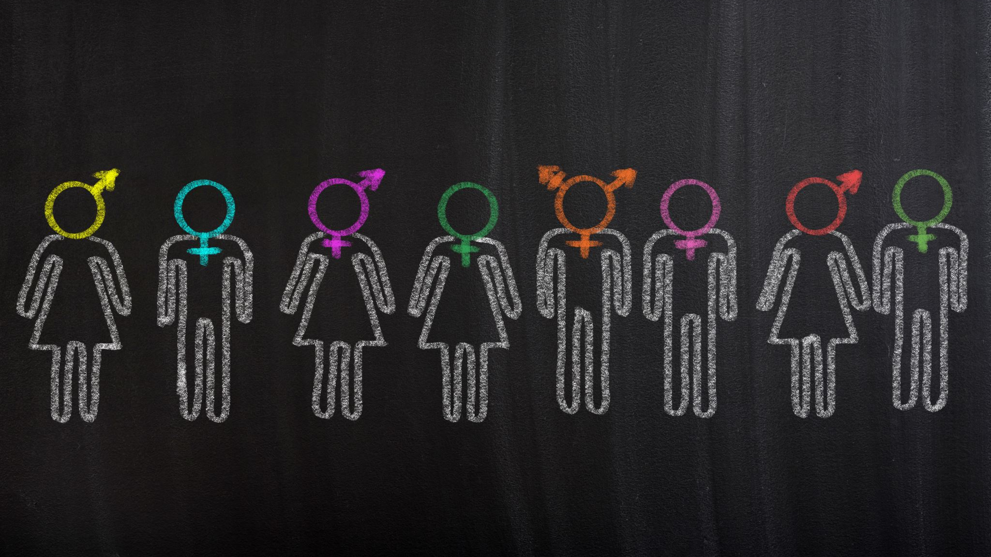
Patient Population Analysis
Population Size: 106 patients.
Age Distribution: 2 to 111 years (diverse life stages).
Gender Distribution: 59 Female, 47 Male (balanced).
Race Distribution: White (88), Asian (8), Black (6), Other (3), Native (1).
Geographical Distribution: Boston (7 patients), Mansfield (1 patient).

Slide 7
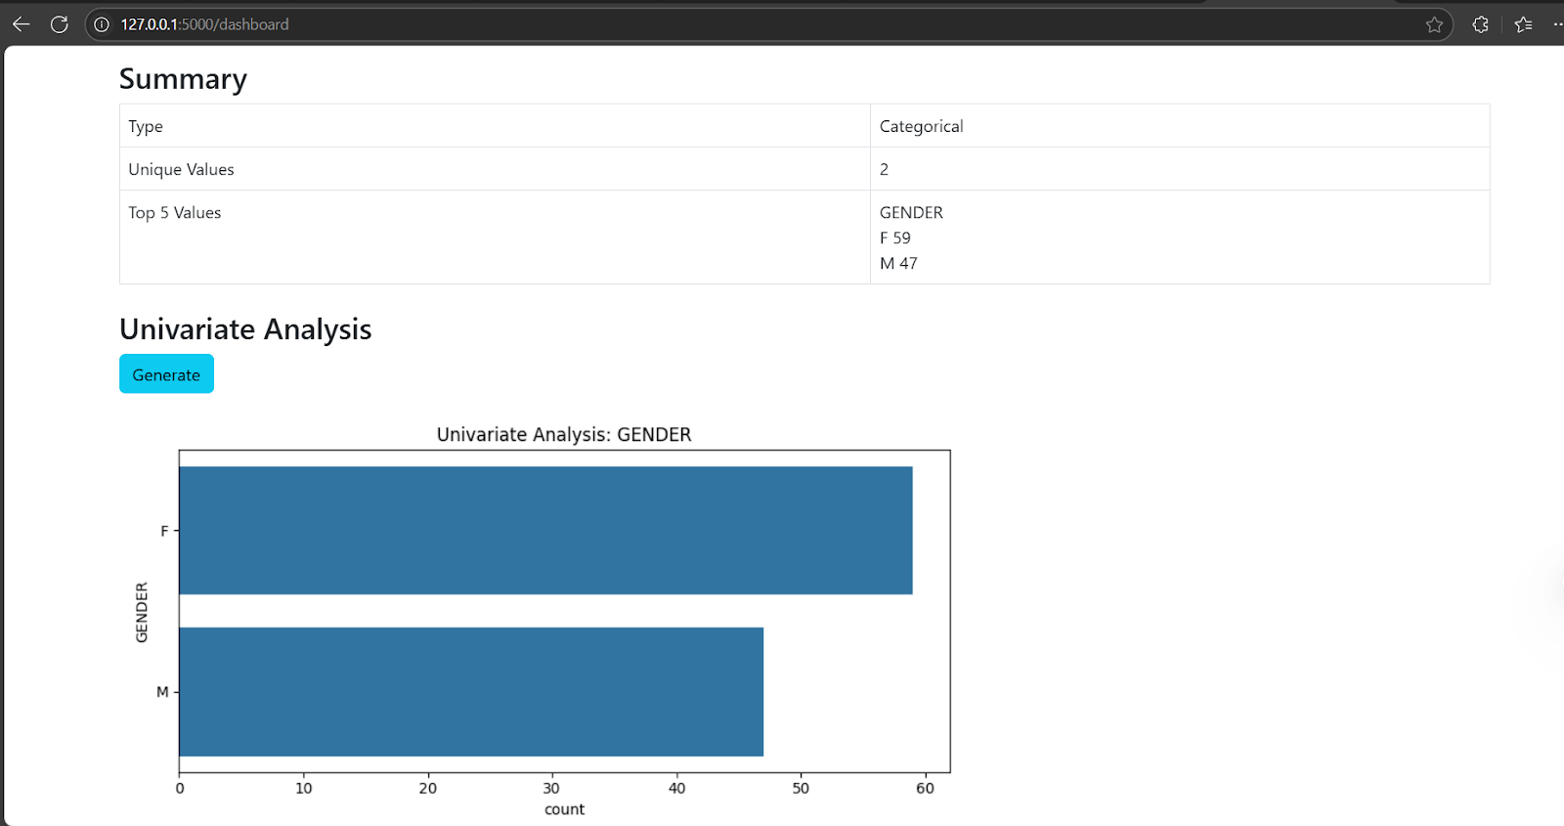
Demonstration
Live Demo: Show the application in action.
Symptom Input: Demonstrate text/voice input.
Disease Suggestions: Show disease suggestions with a confidence score from AI.
Interactive Dashboard: Show filters, parameter adjustments and such things.
Real-Time Updates: Show real time updates on the case depending on the selections made by the user.

Slide 8
Conclusion
Application that is AI powered makes diagnosis faster and more accurate.
Helps close the gap on having accessible healthcare among underserved populations.

Slide 9
Thank you

